Slide 1
Vishal V S-Tira Beauty
Under the Guidance of Mrs. Vaishali Sonanis.

Slide 2
Introduction
Tira Beauty is an online beauty and personal care platform offering skincare, makeup, haircare, and wellness products.
It enables users to browse, search, and shop products online with a smooth checkout experience.
The platform provides personalized recommendations and exclusive offers to enhance the shopping journey.

Slide 3
Overview
What is Tira Beauty?
Tira Beauty is an e-commerce platform offering curated beauty, skincare, haircare, bath & body, and wellness products.
The homepage has organized navigation for easy access to categories like Makeup, Skin, Hair, Fragrance, Mom & Baby, etc.
Spotlight sections include Tira Red, Offers, and For You.
The “What’s New” module highlights latest arrivals and trending products.

Slide 4
Responsibilities
Analyzed requirements and created Epics, Stories, and Tasks in Jira.
Designed test plans and prepared module-wise test cases.
Performed manual and automated testing using Selenium with TestNG and POM.
Reported defects in Jira and maintained execution reports.

Slide 5
Modules
Module 1: Sign In Page Checked all functionalities on the Sign In page, including personal information such as email, password, and login validation.
Module 2: What’s New Verified the “What’s New” module including latest arrivals, trending products, product details, and navigation.
Module 3: Mens Checked all functionalities on the Men page including item details, quantity selection, filters, compare button, add to cart, product info, and grid/list view.

Slide 6
Module 4: Fragrance Validated functionalities on the Fragrance page, including product details, filters, add to cart, wishlist, compare, and display views.
Module 5: Hair Page Verified the Hair page for product details, quantity, filters, add to cart, compare, and product grid/list views.
Module 6: Skin Page Checked all functionalities on the Skin page including item details, filters, quantity selection, add to cart, compare button, and product info.

Slide 7
Defects
During test execution, any functionality that does not behave as expected such as fields, buttons, or features not performing correctly is identified as a defect.
Defects are documented with steps to reproduce, expected vs. actual results, severity, and screenshots.
The defects are then logged in the defect tracking tool (e.g., Jira) for resolution and follow-up by the development team.
This process ensures effective issue management and maintains overall product quality.

Slide 8
Defect Identifier:B_001
Defect Summary: Location change not updating to current location
Test ID: TC_020
Test Case Name: TC_location_change_current_location
Module Name: Location Selector
Reproducible: Open Tira Beauty website -> Navigate to location selector ->Attempt to change location ->Observe displayed location
Severity: High
Priority: High
Raised By: Vishal
Assigned To: Developer / Team Lead
Date of Assignment:
Status: In Progress
Snapshots: Attached
Fixed By: Developer
Date of Fixing:

Slide 9
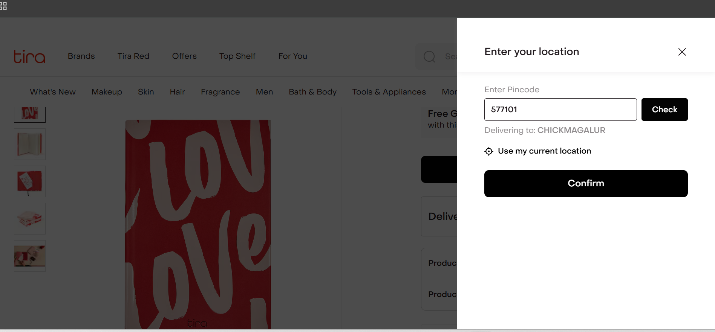

Slide 10
Defect Identifier:B_002
Defect Summary: New trending products not displaying correctly in “What’s New” module.
Test ID: TC_021
Test Case Name:TC_whatsnew_price_sorting
Module Name: What’s New
Reproducible: Open “What’s New” section ->Browse latest products.
Severity: Medium
Priority: Medium
Raised By: Vishal
Assigned To: Developer / Team Lead
Date of Assignment:
Status: In Progress
Snapshots: Attached
Fixed By: Developer
Date of Fixing:

Slide 11
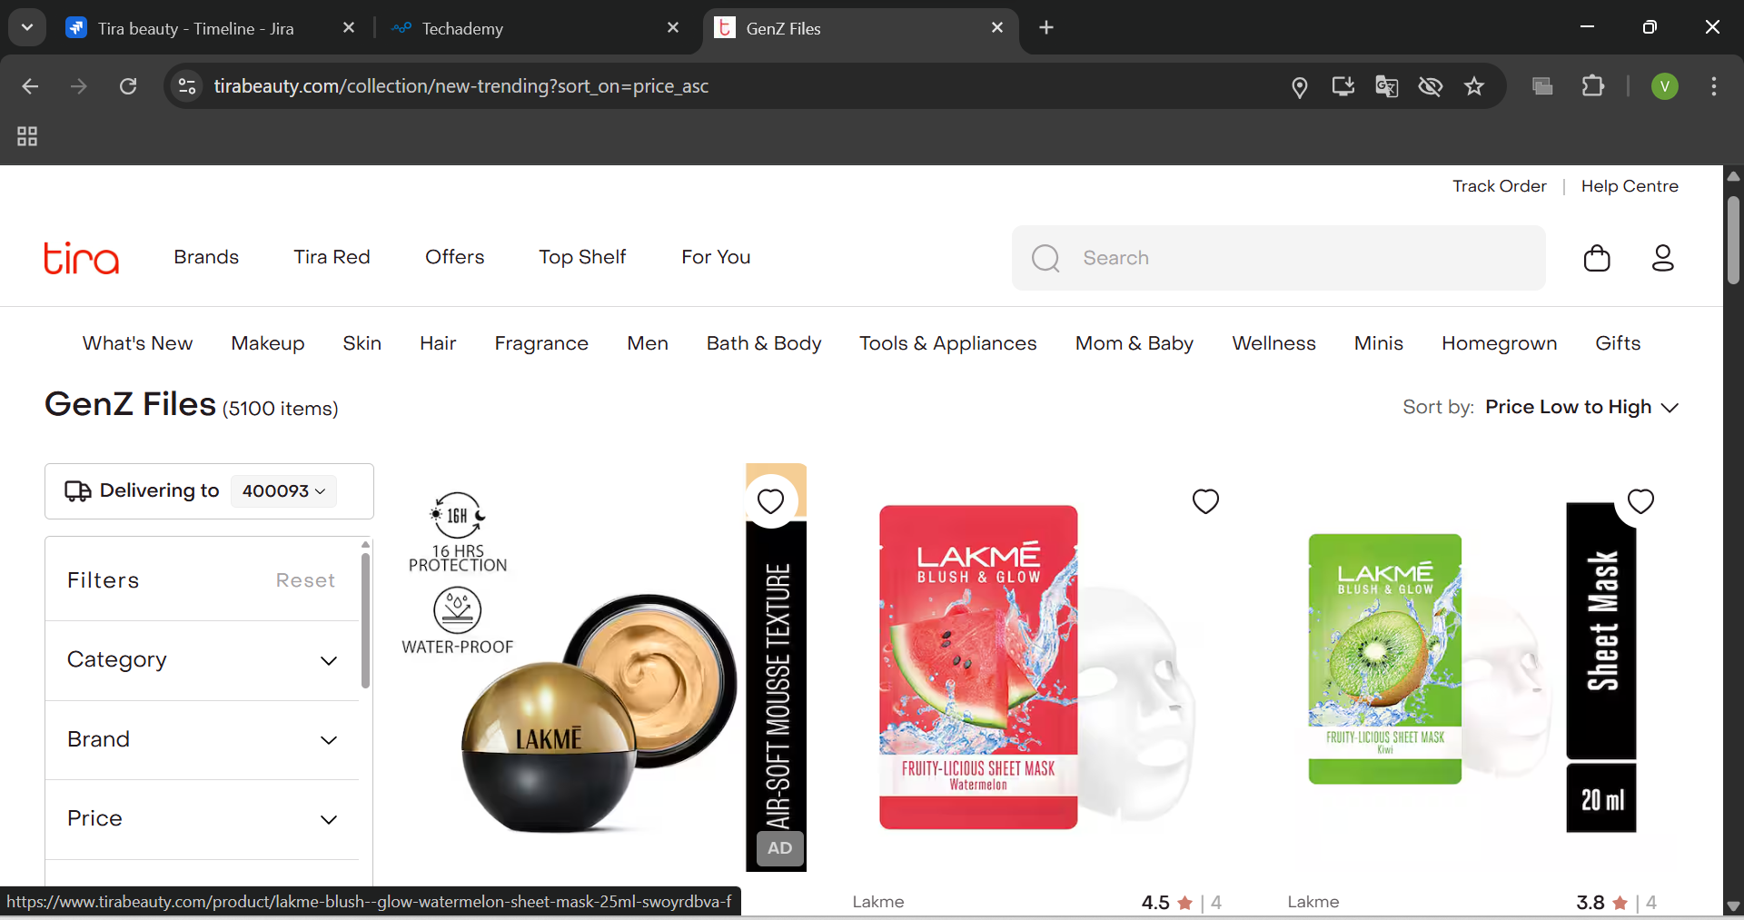

Slide 12
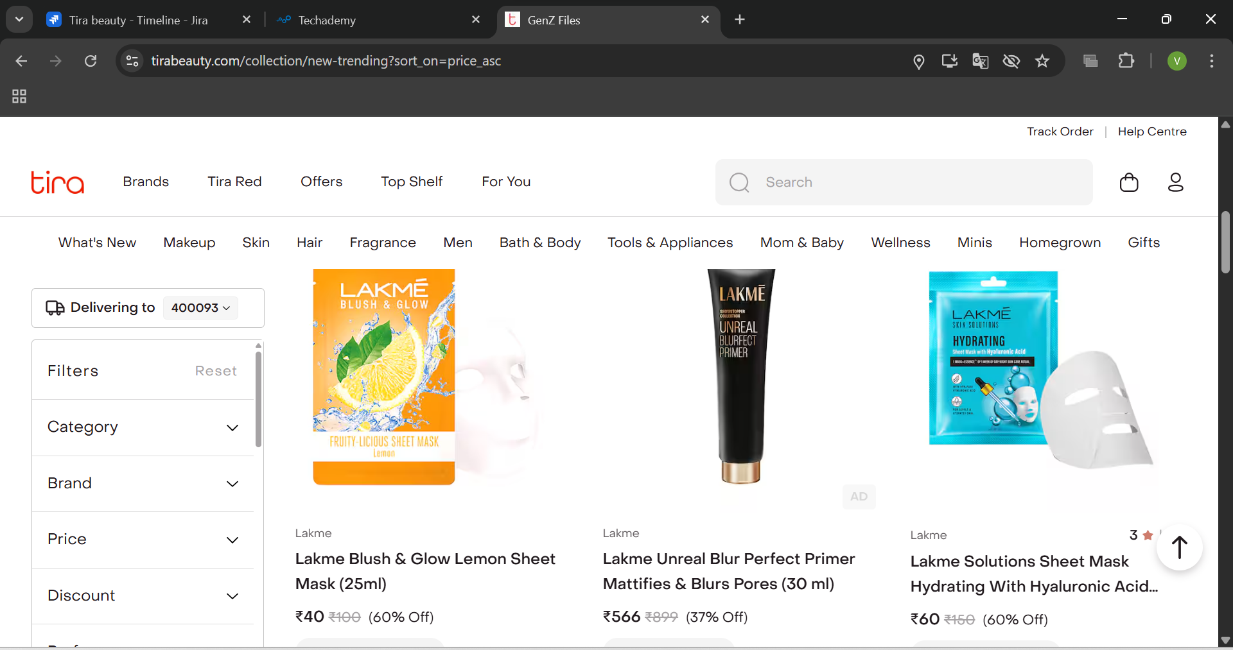

Slide 13
Challenges
Handling dynamic elements across multiple Tira Beauty modules (Login, What’s New, Fragrance, Hair, Skin, etc.).
Identifying defects like incorrect location update, faulty price sorting, and missing trending products.
Maintaining test stability while executing automation test cases with TestNG
Documenting and tracking defects systematically in Jira with detailed evidence.

Slide 14
Experience
Automated key workflows: login, search, add to cart, delete cart, profile update, and shop by category.
Validated multiple submodules of Tira Beauty and reported critical defects (CRM-20, price sorting, store locator, new trending).
Created structured defect reports with severity, priority, and screenshots for better tracking and resolution.
Gained hands-on experience with TestNG, Jira, and end-to-end validation of e-commerce platforms.

Slide 15
Thank You.

